Slide 1
ET0023 Operating Systems
1: Introduction

Slide 2
Contents
Lectures
Lecture 01 Introduction
Lecture 02 Computer System Overview
Lecture 03 Programs and Processes
Lecture 04 Threads
Lecture 05 Process Management & Scheduling
Lecture 06 Interprocess Communication
Lecture 07 Deadlocks
Lecture 08 Memory Management
Lecture 09 Virtual Memory
Lecture 10 Storage
Lecture 11 File Systems
Lecture 12 Linux Operating System
Laboratory
Lab 1 User Administration
Lab 2 Browsing the Filesystem
Lab 3 Process Management
Lab 4 File Management
Lab 5 Network Services

Slide 3
About Your Lecturer
Name: Leong Kin Seng
Office: 12A529
Tel : 67721375
Email: KinSeng@sp.edu.sg

Slide 4
ET0023 OS Overview
• OS Overview
• Computer Organization
• Processes and Threads
• Inter-process Communication (IPC)
• Memory management
• File storage and systems
• Device management

Slide 5
ET0023 Practical
Introduction to Linux
Process control and management
Memory management and monitoring
File systems and storage
Device I/O and management
System services

Slide 6
Assessment
Topic | Percentage | Method
General Performance | 10% | Assignment/Participation
Lab Test | 15% | Linux Commands usage
PBIL Project | 15% | System Services & monitoring
Mid-Semester Test | 20% | Online
Semestral Exam | 40% | Written Paper

Slide 7
Why study OS?
• Manage resources and coordination
• Simplify programming
• Enforce policies e.g. memory, power
• Security and protection
• Portability
• Efficiency
Notes:
The functions of an operating system
User Interface
Job Management
Task Management
Memory Management
File Management
Device Management
Security

Slide 8
What is an OS?
An operating system (OS) is a set of basic programs and utilities that make your computer run. The OS manages computer hardware resources, and provides common services to application software.
The operating system is the most important type of system software in a computer system. Without an operating system, a user cannot run any application program on their computer, unless the application program is self booting.
http://en.wikipedia.org/wiki/Operating_system
Notes:
An operating system (OS) is a collection of software that manages computer hardware resources and provides common services for computer programs. The operating system is a vital component of the system software in a computer system.
Operating systems can be found on almost any device that contains a computer—from cellular phones and video game consoles to supercomputers and web servers.
The OS is the most fundamental piece of software and runs in Kernel mode (also called supervisor mode or System mode ). In this mode it has complete access to all the hardware and can execute any instruction the machine is capable of executing.
The rest of the software runs in user mode, in which only a subset of the machine instructions is available.
Instructions that directly affect control of the machine or do I/O are forbidden to user mode programs.
Users may choose or even write different user-mode software, however, OS software is protected by hardware against attempts by users to modify it.
Application programs usually require an operating system to function.
A process moves from User mode to System mode when It executes system calls e.g. to save a file, or to read a file. In these cases, the process transfers control to the system mode by creating a new process (or requesting a new process) from the Operating System. In this way, the user mode has no direct connection/interaction with the system mode.

Slide 9
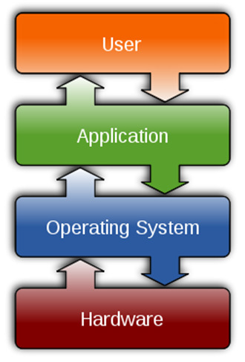
What is an OS?
OS as resource manager
• Many components
• Complex interaction between
components
• Multiple goals and conflicting
purposes
OS is a system software providing abstraction
• Messy, complicated
• Dependent on hardware
Notes:
For hardware functions such as input and output and memory allocation, the operating system acts as an intermediary between programs and the computer hardware, although the application code is usually executed directly by the hardware and will frequently make a system call to an OS function or be interrupted by it.
A system call traps into the kernel and invokes the operating system. Control is returned to the user program at the instruction after the system call.
The user interface program, text-based shell or Graphical User Interface (GUI), is the lowest level of user-mode software and allows the user to start other programs.

Slide 10
Linux Operating System
The kernel is the core of the OS. It is the nerve centre at the heart of OS which does all the basic housekeeping and lets you start other programs.
The kernel is essentially a resource manager that mediates access to the resource available on a system.
The kernel is responsible for enabling multiple applications to effectively share the hardware by controlling access to the processor, memory, disk, networking and other resources
The kernel is the software interface to the computer’s hardware.
It communicates with the CPU, memory and other devices on behalf of any software running on the computer.
It is the lowest level component of software stack. It consists of the essential program code of the OS.
Notes:
The kernel is the most important component of software stack. If the kernel has a problem, every piece of software running on the computer shares in that problem.
In the RHEL 6 OS, the kernel size is 3.7 MB, while there are 85 MB of modules in /lib/modules.
Some drives (such as Nvidia cards) are refers to “restricted drivers”, these drivers are installed from your package manger or otherwise have to be compile from source each time you upgrade your kernel.
Dynamic Kernel Module Support (DKMS) automatically recompiles all third-party modules when a new kernel is installed, making the process of upgrading a kernel almost as seamless as upgrading user applications.

Slide 11
The Role of Software
Translates user requests into machine instructions
Performs complex translation process that bridges two gaps Human language to machine language (binary)
High-level abstraction to low-level detail
Application program
Stored set of instructions for responding to a specific information-processing tasks
Used directly by end users
Utility program
Contains instructions for performing general-purpose tasks
Usually operates invisibly in the background
System software
Implements utility functions needed by many application programs
Allocates computer resources to application programs
Manages computer resources
Does not interact with end users

Slide 12
System Software Layers
System management
System services
Resource allocation
Hardware interface

Slide 13
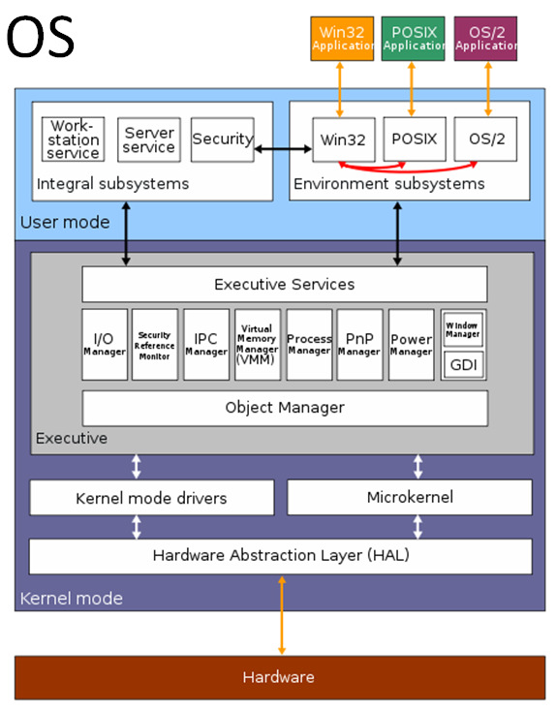
Windows OS
Chrome OS Guided Tour http://youtu.be/XxbUT_PwZKo
Notes:
What is the market shares of various OS? http://www.theregister.co.uk/2014/03/15/windows_desktop_and_laptop_market_share_dips_below_90_per_cent/
Year Windows OS Mac iOS Linux
2008 95 3.75 0.62
2014 89.90 8.34 1.76
Windows on 3% of mobile phones and only 14 % of all devices.
Linux is installed on 97% of top 500 computers. http://Top500.org

Slide 14
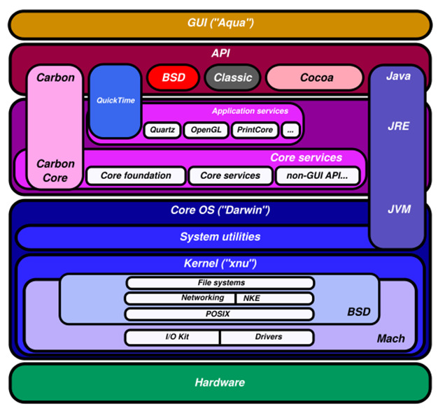
Mac OSX
Notes:
Mac OSX with a UNIX core which is a product of the open source development community.
Built-in Multimedia Hardware and Software in Mac OS.
Ease of use of the Mac OS – contain many extra as standard system configuration.
Mac OS has only a few hardware platforms, built with the same basic architecture.
Single source of hardware, OS and software, thus having fewer component/software conflicts.

Slide 15
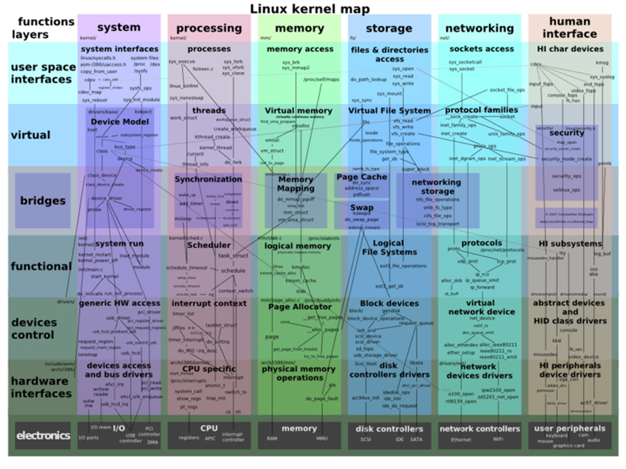
Linux OS
Notes:
Linux is a free OS that share the same qualities as UNIX, has the potential to save corporations millions of dollars.
Not an easy OS, need to configure system and train users.
Reasons for learning Linux: Qualification for IT jobs and improve your computer skill.
Benefits and features
Linux is free or inexpensive
Linux can run on old equipment
Linux is fast
Linux can have a GUI and shell
Linux is stable
Linux is secure
Linux is open source
Drawbacks
Lack of centralized support
Limited software selection
Limited hardware support
Complexity

Slide 16
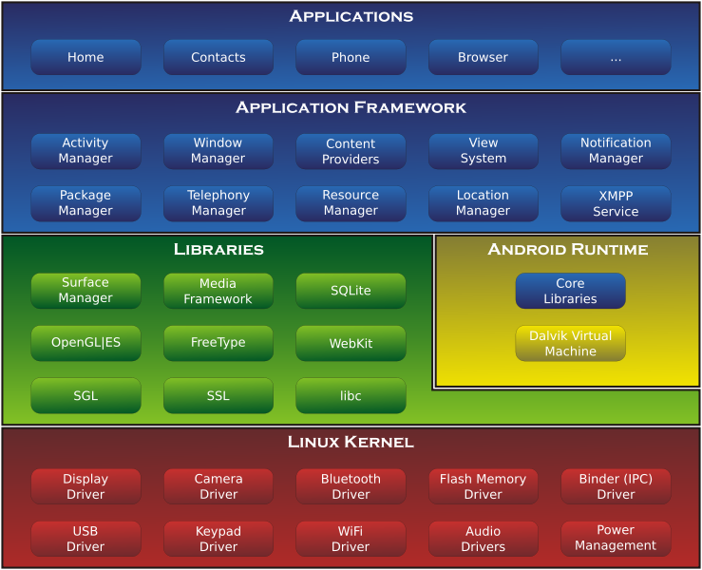
Android's architecture diagram

Slide 17
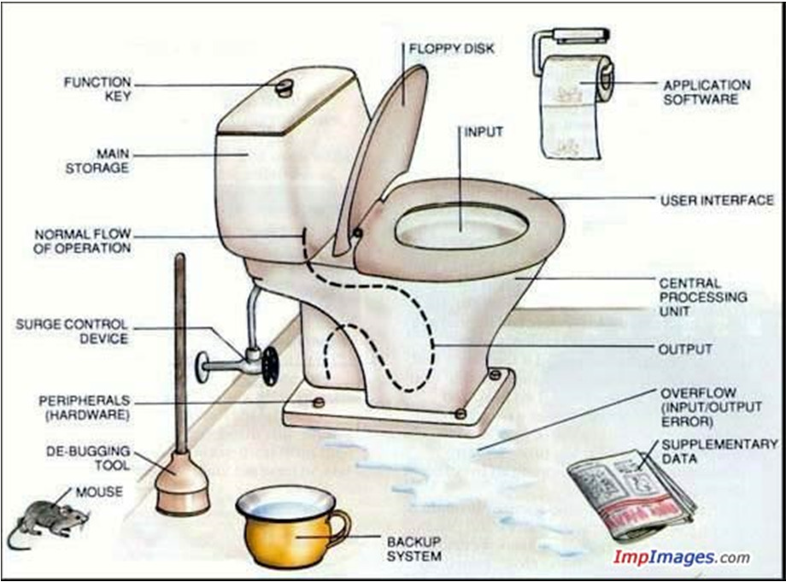

Slide 18
Checkpoint Questions
Q1. What is an operating system? What are the functions of OS in a computer?
Q2. Which one is not a component of an OS?
The kernel
Resource manager
Device drivers
Application software
BIOS
Q3. What is the version of your hand phone operating system’s kernel ?
Notes:
D
The OS manages the communication among the application programs, the user and the computer.

Slide 19
A Brief History of Computer
We need to look a the history of computers to understand the evolution of OS
Why OS? What OS? Which OS?
Shows the development of Computer Systems with Operating Systems
Compare different types of OS
Matching technology trends
Notes:
A computer is a mechanical or electronic device that can efficiently store, retrieve and manipulate large amounts of information at high speed and with great accuracy. Moreover, it can execute tasks and act upon intermediate results without human intervention. It does this by carrying out a list of instruction called a program.
System architecture describes the structure, interaction and technology of computer system components.

Slide 20
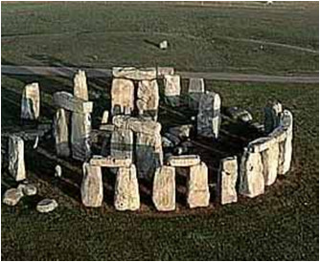
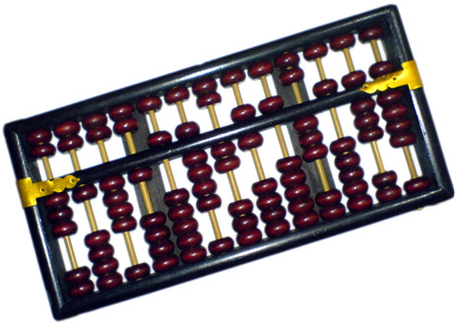
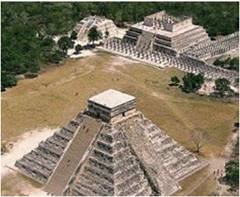
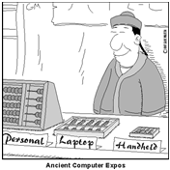
Ancient computers

Slide 21
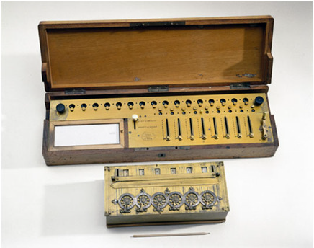
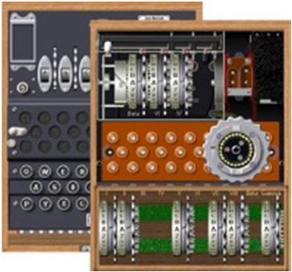
Analog Computers
www.youtube.com/watch?v=HwNGF6te_6A
The Men Who Cracked Enigma http://www.youtube.com/watch?v=eoK4i0SU3DA
Notes:
An Enigma machine is any of a family of related electro-mechanical rotor cipher machines used for the encryption and decryption of secret messages. Enigma was invented by the German engineer Arthur Scherbius at the end of World War I.^{[1]} The early models were used commercially from the early 1920s, and adopted by military and government services of several countries — most notably by Nazi Germany before and during World War II.^{[2]} Several different Enigma models were produced, but the German military models are the ones most commonly discussed.
https://en.wikipedia.org/wiki/Enigma_machine

Slide 22
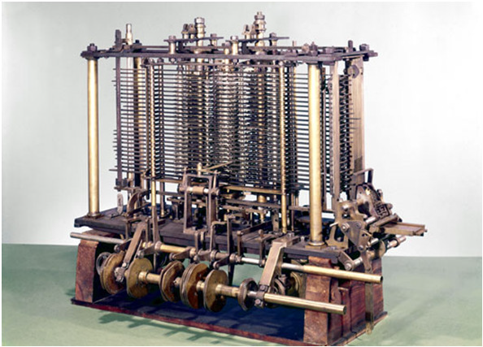
First "True" Computer
Babbage Analytical Engine
The Analytical Engine incorporated an arithmetical unit, control flow in the form of conditional branching and loops, and integrated memory,
Making it the first Turing-complete design for a general-purpose computer
Limitations:
Complex design and construction
Wear and breakdown
Operating speed
http://www.youtube.com/watch?v=jiRgdaknJCg
https://en.wikipedia.org/wiki/Analytical_Engine
Notes:
The Analytical Engine was a proposed mechanical general-purpose computer designed by English mathematician Charles Babbage.^{[2]}
It was first described in 1837 as the successor to Babbage's Difference engine, a design for a mechanical computer. The Analytical Engine incorporated an arithmetic logic unit, control flow in the form of conditional branching and loops, and integrated memory, making it the first design for a general-purpose computer that could be described in modern terms as Turing-complete.^{[3][4]}
Babbage was never able to complete construction of any of his machines due to conflicts with his chief engineer and inadequate funding.^{[5][6]} It was not until the 1940s that the first general-purpose computers were actually built.

Slide 23
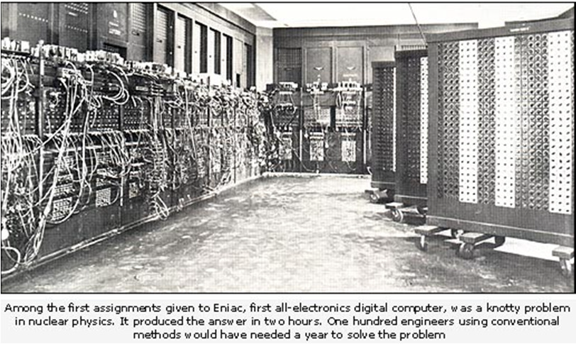
Eniac
First general purpose computer (1946) http://www.youtube.com/watch?v=k4oGI_dNaPc
• US $0.5 Million
• 0.005mips http://en.wikipedia.org/wiki/ENIAC
Notes:
ENIAC (Electronic Numerical Integrator And Computer) was the first electronic general-purpose computer. It was Turing-complete, digital, and capable of being reprogrammed to solve a full range of computing problems.
ENIAC was designed to calculate artillery firing tables for the United States Army's Ballistic Research Laboratory. When ENIAC was announced in 1946 it was heralded in the press as a "Giant Brain“. It had a speed of one thousand times that of electro-mechanical machines. It could accurately perform up to 5000 additions per second.

Slide 24
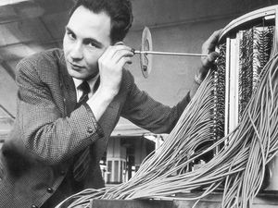
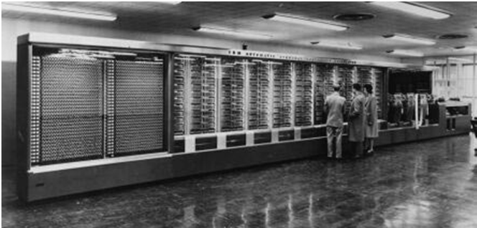
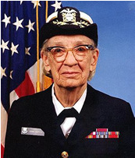
Harvard Mark 1
The Ferranti Mark 1: World’s First Commercially Available General-Purpose Computer
Grace Hopper
One of the first
programmers .
Conceived "debugging"
1944 The IBM Automatic Sequence Controlled Calculator (ASCC), called the Mark I by Harvard University, was an electromechanical computer.
History: The Ferranti Mark 1: World’s First Commercially Available General-Purpose Computer
Computer History http://www.youtube.com/watch?v=4diPtsUv3sg
Notes:
Around 1940, Howard Aiken’s Mark I, at Harvard University, could not act independently on its intermediate results.
Atanasoff and Berry computer, at Iowa State University, required frequent intervention by an operator during its computations.

Slide 25
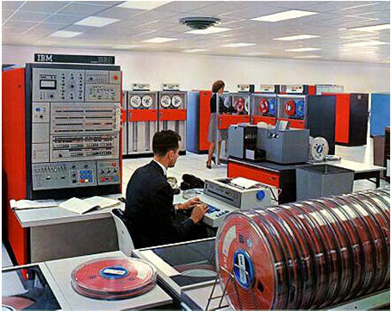
Mainframe Systems
http://www-03.ibm.com/ibm/history/exhibits/mainframe/mainframe_PP2050.html
IBM 360 General Purpose commercial computer
Common architecture, instructions, OS
Most expensive computer US$5M (1964)
Can be used for business, military, scientific
Notes:
The IBM System/360 Model 50 had approximately ten times the internal power of the Model 30 when performing a mix of computations. It was the most powerful unit in the medium price range with communication facilities.

Slide 26
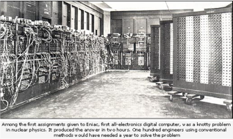

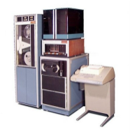
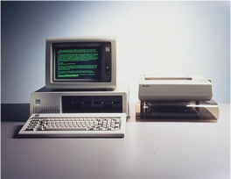
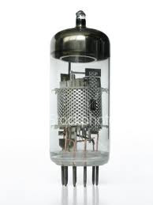
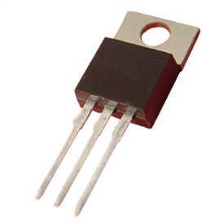
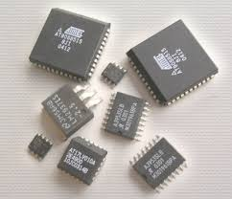
History of Computers
 | 1st Generation | 2nd Generation | 3rd Generation | 4th Generation
Period | 1940-1956 | 1956-1963 | 1964-1980 | 1981 – present
Build Tech | Vacuum Tubes | Transistors | Integrated Circuits | VLSI
Construction | Large buildings ENIAC 1 | Mainframes | Minicomputers | Personal Computers & Workstations
OS Type | Embedded, Single purpose | Batch processing systems | Spooling, Multi-user, multi-tasking | Time-slice, Multi-user, Multi-tasking
Notes:
1st Generation 2nd Generation 3rd Generation 4th Generation
Period 1940-1956 1956-1963 1964-1980 1981 – present
Build Tech Vacuum Tubes Transistors Integrated Circuits VLSI
Construct Large buildings ENIAC 1 Mainframes Minicomputers Personal Computers & Workstations
OS Type Embedded, Single purpose Batch processing systems Multi-user, multi-tasking Multi-user, Multi-tasking

Slide 27
Checkpoint Questions
Q1. Which of the following is not true?
A computer is a mechanical or electronic device.
A computer can efficiently store, retrieve and manipulate large amount of information.
A computer must be able to communicate over the Internet.
A computer works at high speed with great accuracy.
Q2. What technological inventions led to the creation of the world’s first personal computer?
Q3. Briefly define the term cloud computing.
Notes:
C
A microchip is a piece of silicon about the size of a postage stamp, packed with thousands of electronic components.
The microchip and microprocessor, led to the creation of the world’s first personal computer.
Cloud computing is a model for enabling ubiquitous, convenient, on-demand access to a shared pool of configurable computing resources. A model for delivering information technology services in which resources are retrieved from the internet through web-based tools and applications, rather than a direct connection to a server. Data and software packages are stored in servers. However, cloud computing structure allows access to information as long as an electronic device has access to the web.

Slide 28
What OS? No OS! 1st Generation
Programs
Hardware
Programs ran directly on hardware
One computer – One job
Every program has to deal with hardware, memory, devices
Re-programming was done physically
– Rewiring, new electrical connections
– Change in the design
The History Of Operating Systems
Notes:
An operating system is a collection of programs that give a computer the critical functionality that lets you use it for work and entertainment.
Batch Processing Executing a series of non-interactive jobs one at a time until completion Cmd line batch file
Spooling The process of placing data in a temporary working area for another program to process By queuing jobs sent to a printer
Time Slice operations The systems assigns a processor time slicing to one thread after another, depending on each thread needs. When a thread’s time slice comes to an end the operating system suspends the threads execution and another thread starts running.
Multi-tasking It is the method where multiple tasks are performed during the same period

Slide 29
Batch Systems 2nd Generation
Programs
Job 1
Job 2
Job 3
OS
Hardware
OS runs 1 job at a time
Programs are input serially (from punched cards/tape)
OS handles
– Input of information
– Specifications of job, resources needed
– Scheduling of process/job
– Output
Notes:
Programmers programmed jobs in punch cards.
A collection of jobs are read into a magnetic tape.
The operator loaded a special program that read the first form tape and ran it.
The output was written on tape to be printed later.
After each job finished, the OS automatically read the next job from the tape and began running it.
Batch Processing: Execution of a series of jobs one at a time without manual intervention

Slide 30
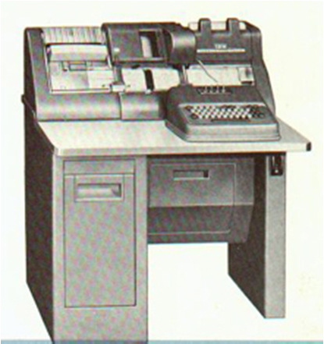
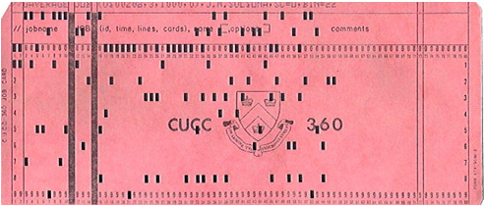
Punched Cards
Each card holds a single command.
Groups of cards form a program
The secret is in the "holes"

Slide 31
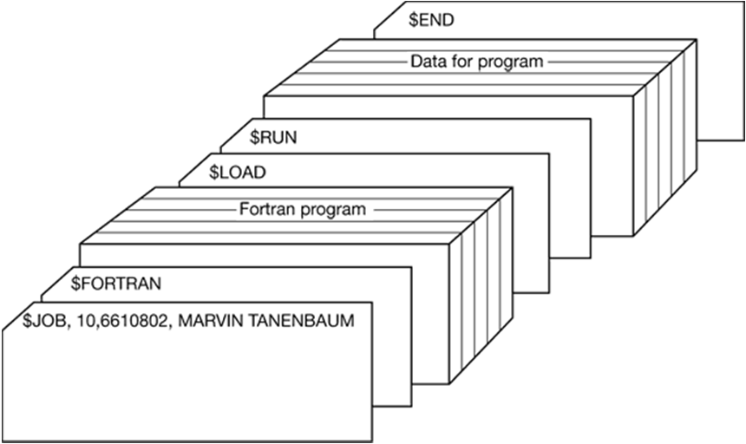
Structure of a Job
Notes:
Starting with $JOB card, specify the maximum run time in minutes, the account number to be charged, and the programmer’s name.
Then $FORTRAN card, telling the OS to load the FORTRAN compiler from the system tape.
It was directly followed by the program to be compiled and
then a $LOAD card, directing the OS to load the object program just compiled.
Next came the $RUN card, telling the OS to run the program with the data following it.
Finally, the $END card marked the end of the job.

Slide 32
Multi-programmed Batch OS
• Batch processing is inefficient
– One job at a time
– CPU idle when jobs are being read in
– CPU idle when output is generated
– Each job "knows" the resources required
Multiprogramming loads multiple jobs and runs other jobs when I/O is needed
Runs multiple jobs, each in its own environment
Job 3
Job 2
Job 1
OS
memory partitions
Notes:
In computing, multitasking is a method where multiple tasks, also known as processes, are performed during the same period of time. The tasks share common processing resources, such as a CPU and main memory. In the case of a computer with a single CPU, only one task is said to be running at any point in time, meaning that the CPU is actively executing instructions for that task. Multitasking solves the problem by scheduling which task may be the one running at any given time, and when another waiting task gets a turn. The act of reassigning a CPU from one task to another one is called a context switch. When context switches occur frequently enough the illusion of parallelism is achieved. Even on computers with more than one CPU (called multiprocessor machines), multitasking allows many more tasks to be run than there are CPUs.
Multiprogramming, the ability to have several programs in memory at once, each in its own memory partition.
While one job was waiting for I/O to complete, another job could be using the CPU.
Special hardware kept one program form interfering with another.

Slide 33
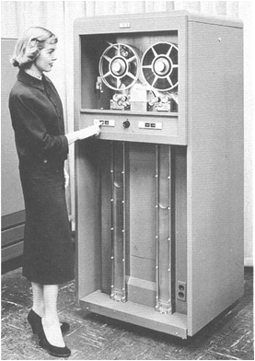
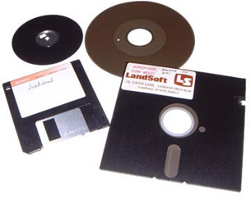
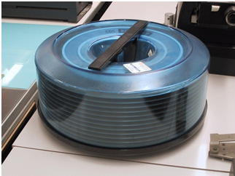
Magnetic Storage
Punch cards and tape were slow
Magnetic components e.g. tape, floppies and hard disk drives improved I/O
Notes:
Spooling (Simultaneous Peripheral Operation On Line)
A collection centre for other jobs or input to be use by another process.
The most common spooling application is print spooling: documents formatted for printing are stored usually into an area on a disk and retrieved and printed by a printer at its own rate. Printers typically can print only a single document at a time and require seconds or minutes to do so. With spooling, multiple processes can write documents to a print queue without waiting. As soon as a process has written its document to the spool device, the process can perform other tasks, while a separate printing process operates the printer.

Slide 34
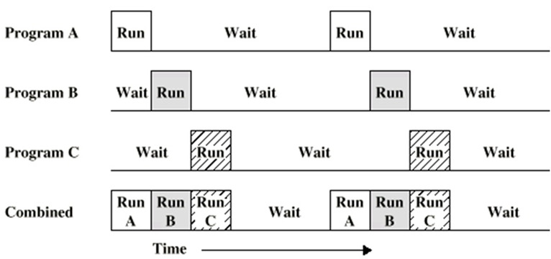
Timesharing
Allows multiple users to interact with the machine using terminals
Each user "time-slices" a slot of the CPU's attention.
Requires scheduling of user jobs, management of memory, Illusion of concurrency
Notes:
In computing, time-sharing is the sharing of a computing resource among many users by means of multiprogramming and multi-tasking. Its introduction in the 1960s, and emergence as the prominent model of computing in the 1970s, represents a major technological shift in the history of computing.
By allowing a large number of users to interact concurrently with a single computer, time-sharing dramatically lowered the cost of providing computing capability, made it possible for individuals and organizations to use a computer without owning one, and promoted the interactive use of computers and the development of new interactive applications.
Operating systems may adopt one of many different scheduling strategies, which generally fall into the following categories:
In multiprogramming systems, the running task keeps running until it performs an operation that requires waiting for an external event (e.g. reading from a tape) or until the computer's scheduler forcibly swaps the running task out of the CPU. Multiprogramming systems are designed to maximize CPU usage.
In time-sharing systems, the running task is required to relinquish the CPU, either voluntarily or by an external event such as a hardware interrupt. Time sharing systems are designed to allow several programs to execute apparently simultaneously.
In real-time systems, some waiting tasks are guaranteed to be given the CPU when an external event occurs. Real time systems are designed to control mechanical devices such as industrial robots, which require timely processing.

Slide 35

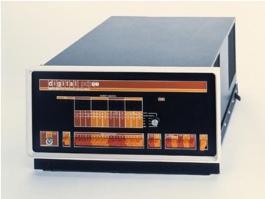
Minicomputers 3rd Generation
Cheaper than mainframes
Smaller in size
Efficient and fast, they were the work horses of the 70s-80s
Digital Equipment Corp (PDP-8)

Slide 36
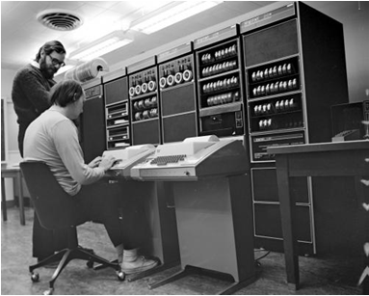

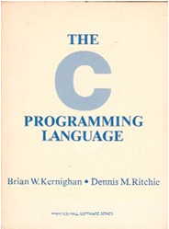
C & Unix
Developed on DEC/PDP minicomputers
C programming language (K & R)
Unix OS
Notes:
OS’s are normally written in C or C++.
It is the total programmer control over memory along with explicit pointers that makes C attractive for writing OS.
OS are basically general purpose real-time systems.

Slide 37
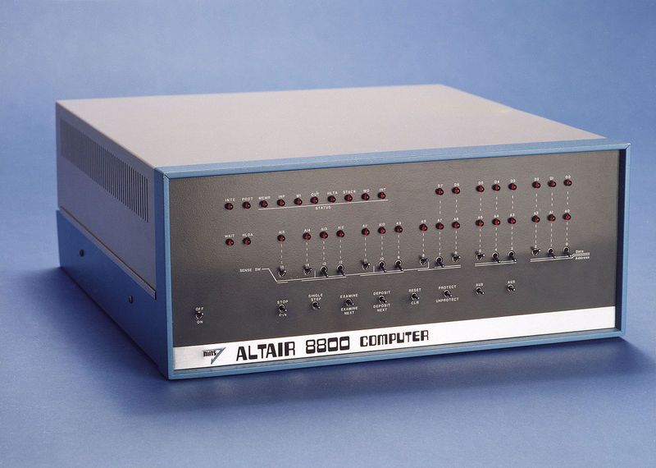
The Personal Computer 4th Generation
First publically available computer (sold as a kit)
Used toggle switches and LEDs
Did nothing, but changed sounds on a radio
Later ran Basic interpreter by Bill Gates & Paul Allen
Innovations:
8080 Microprocessor
S-100 Bus
The First Microcomputer
Altair 8800
Notes:
The Altair 8800, produced by Micro Instrumentation and Telemetry Systems (MITS), and invented by Ed Roberts, was originally sold as a kit. It had no operating system, but did recognize commands entered via a row of switches. The Altair had no keyboard and could not be connected to a television screen.

Slide 38
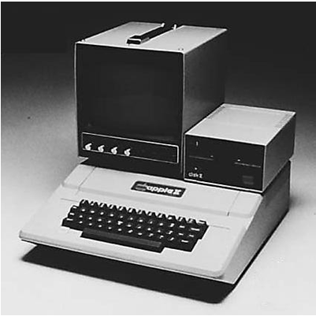
Apple
Apple I, II designed by Steve Wozniak
First successfully produced mass computer
Apple founded by Jobs and Wozniak
General purpose DOS
Notes:
The original Apple Computer, also known retroactively as the Apple I, or Apple-1, is a personal computer released by the Apple Computer Company (now Apple Inc.) in 1976. They were designed and hand-built by Steve Wozniak.^{[1][2]} Wozniak's friend Steve Jobs had the idea of selling the computer. The Apple I was Apple's first product. It was demonstrated in July 1976 at the Homebrew Computer Club in Palo Alto, California.^{[5]}

Slide 39

IBM PC
First generic PC
Common components
Multiple OS
Multiple peripherals
Backed by the "Giant"
Debut of the Personal Computer and Workstations
http://www-03.ibm.com/ibm/history/exhibits/pc25/pc25_PH01.html
Notes:
The IBM Personal Computer, commonly known as the IBM PC, is the original version and progenitor of the IBM PC compatible hardware platform. It is IBM model number 5150, and was introduced on August 12, 1981. It was created by a team of engineers and designers under the direction of Don Estridge of the IBM Entry Systems Division in Boca Raton, Florida.
Instead of proprietary components, the team decided to build the machine with "off-the-shelf" parts from a variety of different original equipment manufacturers (OEMs) and countries.
The success of the IBM computer led other companies to develop IBM Compatibles, which in turn led to branding like diskettes being advertised as "IBM format". An IBM PC clone could be built with off-the-shelf parts, but the BIOS required some reverse-engineering. The IBM PC became the industry standard.

Slide 40
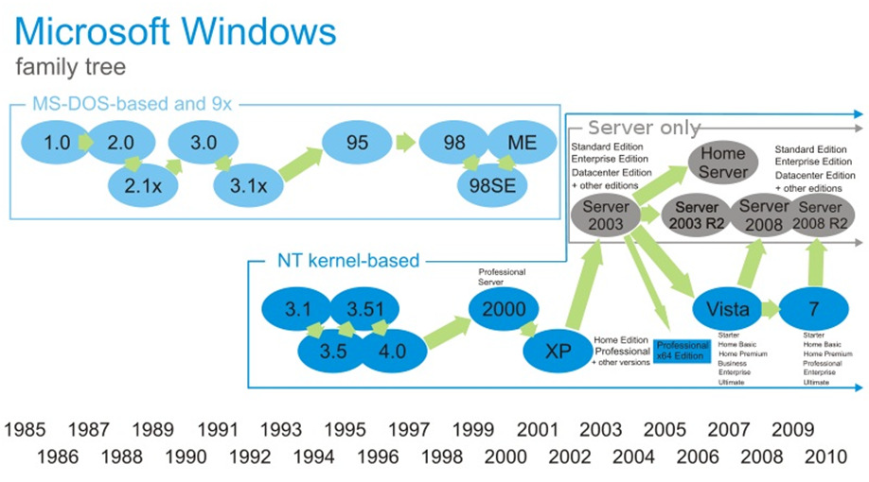
Microsoft OS
http://lead-central.blogspot.com/2010/06/microsoft-windows-historyat-glance_19.html
Notes:
MS-DOS (pron.: /ˌɛmɛsˈdɒs/ EM-es-DOSS; short for Microsoft Disk Operating System) is an operating system for x86-based personal computers. It was the most commonly used member of the DOS family of operating systems, and was the main operating system for IBM PC compatible personal computers during the 1980s to the mid-1990s, until it was gradually superseded by operating systems offering a graphical user interface (GUI), in particular by various generations of the Microsoft Windows operating system.
MS-DOS grew from a 1981 request by IBM for an operating system for its IBM PC range of personal computers.

Slide 41
Windows Development Complexity
• Single user command line MS-DOS
• Single user GUI systems MS Windows 1
• Multiprogram OS MS Windows 3
• Multiprogram, multi user MS Windows NT
MS Windows 2000 (shipped 1999)
• Development Team Size: 1400
• 180 Source Projects
• Full Source Base about 50Gb of disk space
• Complete build time: 8 hours on PIII Xeon 550, 50Gb HD, 512K Ram
• Stress test on ~1000 Systems
Notes:
Predicting the Future Wrong
http://www.ahajokes.com/fp044.html
http://www.makeuseof.com/tag/8-spectacularly-wrong-predictions-computers-internet/
The History Of Operating Systems

Slide 42
Modern Operating Systems
Multitasking concurrent execution of programs
Single/Multiprocessor operation
Single/Multi user systems
What is a kernel mode?
What is a user mode?
Web Browser
Music Player
Email reader
User Interface Program
Operating system
Hardware
User mode
Kernel mode
Notes:
Desktop and Laptops Ease of access, graphical interfaces. Windows, Linux and Mac OS X
Servers Provide services to many other networked-clients
Handheld Devices Proprietary Oss include Google’s Android, Palm’s webOS, Apple’s iOS and Window’s Mobile
The modern OS contains 3 major components
1. The kernel OS and its utility programs
2. ROM-BIOS There is one ROM chip on the system board that contains BIOS, which manages the startup process (startup BIOS) and many basic functions of the system (system BIOS)
Device drivers In computing, a device driver is a computer program that operates or controls a particular type of device that is attached to a computer.^{[1]} A driver typically communicates with the device through the computer bus or communications subsystem to which the hardware connects.
Kernel space is memory that can only be accessed by the kernel, no user programs can write to the Kernel space .
User space can be access by any program with the appropriate privileges.

Slide 43
Real Time OS (RTOS)
Some systems have time constraints, periodicity, deadlines, response rates
Critical systems e.g. Aircraft flight systems, nuclear power plants, radar systems
Consumer Appliance e.g. mobile phones, video players

Slide 44
Embedded OS
• Specialised devices and applications
• Potential restrictions
– Power requirements
– Physical size
– Specific purpose
– Real time requirements
– Memory limitations

Slide 45
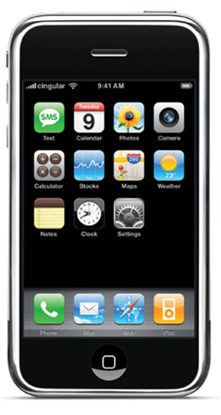
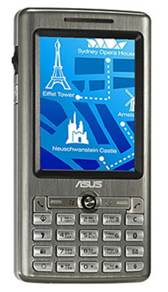
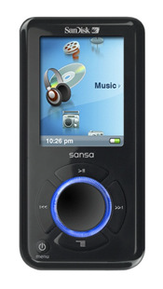
OS Thin Line
MP3
Embedded OS
Smart Phone
RTOS
iPhone
General Purpose OS
What are thick, thin and zero clients?
Notes:
A fat client (also called heavy, rich or thick client) is a computer (client) in client–server architecture or networks that typically provides rich functionality independent of the central server. Originally known as just a "client" or "thick client"^{[1]} the name is contrasted to thin client, which describes a computer heavily dependent on a server's applications.
A fat client still requires at least periodic connection to a network or central server, but is often characterised by the ability to perform many functions without that connection. In contrast, a thin client generally does as little processing as possible and relies on accessing the server each time input data needs to be processed or validated.
Zero client, also known as ultrathin client, is a server-based computing model in which the end user's computing device has no local storage. A zero client can be contrasted with a thin client, which retains the operating system and each device's specific configuration settings in flash memory.

Slide 46
Summary
An operating system (OS) is a collection of software that manages computer hardware resources and provides common services for computer programs.
The kernel is the software engine that drives a computer
Desktop GUI / shell is the human interface that enables the user to interact with the kernel.
Modes of operation
Batch Processing: Executing a series of non-interactive jobs one at a time until completion.
Spooling: placing programmes/data in a temporary buffer for serial processing.
Time Slice operations: The systems assigns a processor time slicing to one thread after another, depending on each thread needs.
Operating System Basics https://youtu.be/9GDX-IyZ_C8

Slide 47
QUESTIONS?

